Slide 1

By: Manas Tuwani

Slide 2
ACCESS SPECIFIERS IN JAVA
We are using Access specifiers to provide access permissions to variables, methods and constructors in java. There are 4 different access specifiers available in java.
1. Public
2. Private
3. Protected
4. Default

Slide 3
1. Public:
Public access specifier allows variables, methods, constructors anywhere (other packages also)
2. Protected:
Protected access specifier allows variables, methods, constructors only within the same
package. (All classes in package)

Slide 4
Private:
Private access specifier allows variables, methods, constructors only within the same class.
Default:
Default (No Access Specifier) access specifier allows variables, methods, constructors only within the same package. (All classes in package)

Slide 5
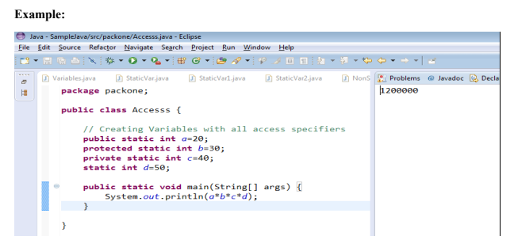
Note: As per the above example all access specifiers are allowing variables to access in the same class

Slide 6
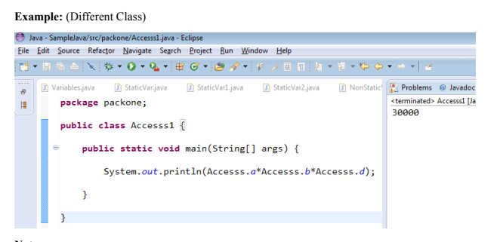
Note: As per the above example we can’t access private access specifier in other classes.

Slide 7
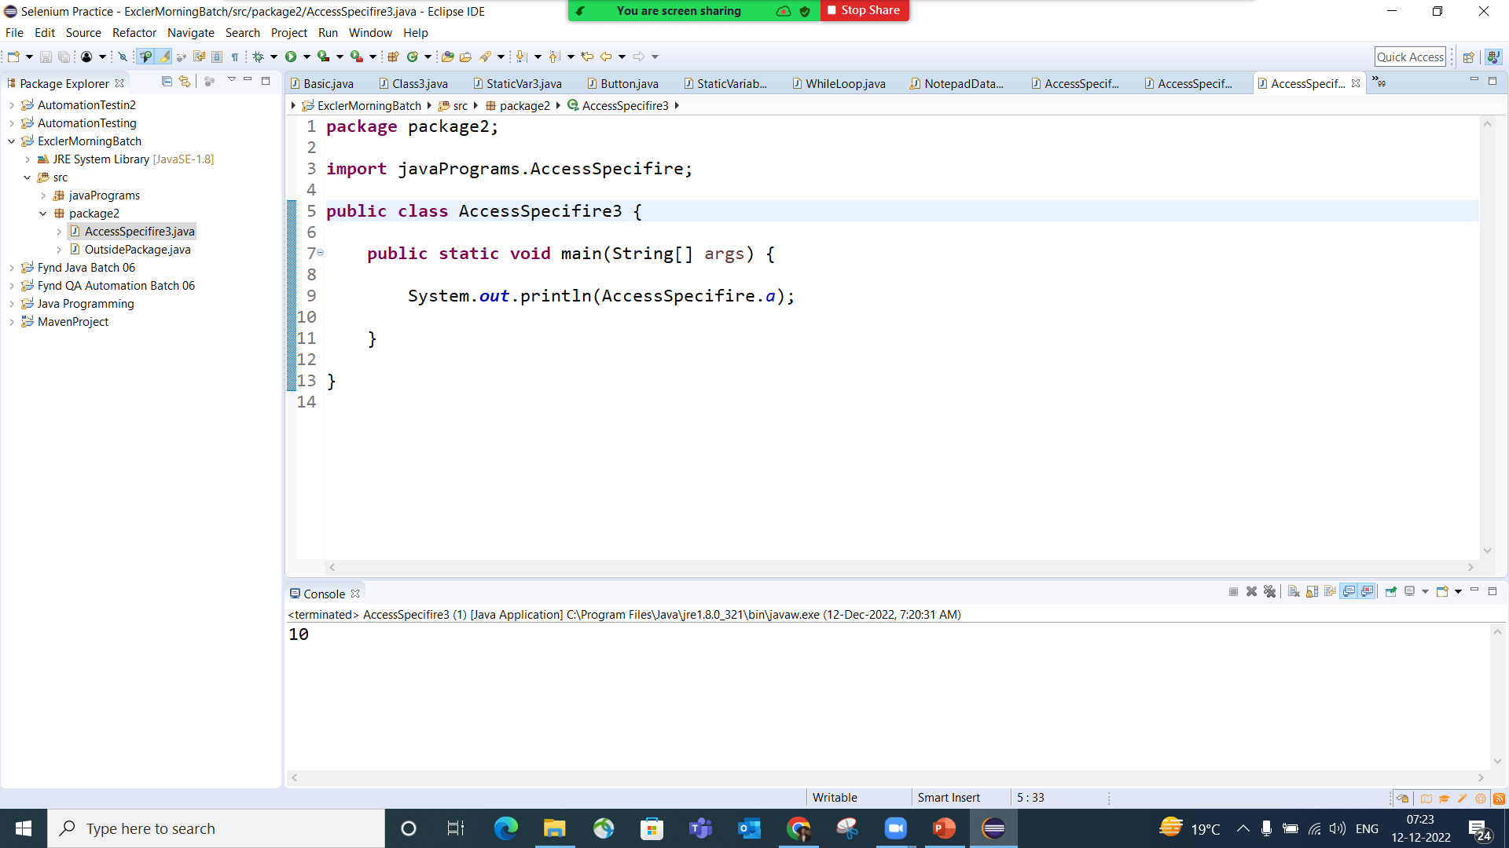
Outside the Package

Slide 8
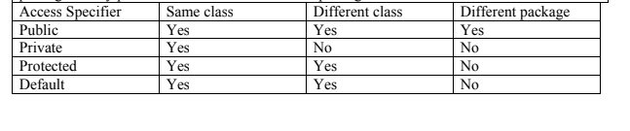
Summary
Note: We are using Access Specifier in case of Global Variable only.

